Slide 1
Digital to Analog Converters (DACs)
Eric Prebys

Slide 2
Digital to Analog Converter (DAC)
In general, a DAC will map a (binary) number D to an output analog signal A
Depending on our application, there are many possible mappings, but for now we’ll focus on “linear” conversion, in which an n-bit integer D produces a range of voltages between A_{min} and A_{max}, given by

Slide 3
Bipolar DACs
In all of our previous examples, if we replace GND with V_{min} and V_{ref} with V_{max}, then
If V_{min}=-V₀ and V_{max} = +V₀
The natural encoding is “offset binary”
  Some chips accept different encodings and convert them internally
(go to demo)

Slide 4
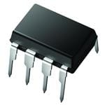
Commercial DACs range from...
Microchip MCP4921-E/P
  Resolution: 12 bit
  Data Input: serial
  Settling time: 4.5 μs
  Max rate: ~100 KHz
  Price: 1@$2.08/each, 100@$1.49/each

Slide 5
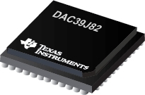
to...
TI DAC39J82
  Channels: 2
  Input: parallel
  Resolution: 16-bit
  Rate: 2 Gs/second
  Price: 1000@$87.50/each

Slide 6
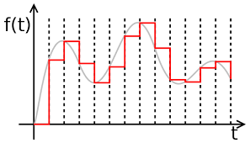
Finite Sampling
A DAC produces an approximation of a waveform by outputing samples at discreet intervals
There are limits to this approximation

Slide 7
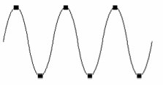
Nyquist’s Theorem
We need a sampling frequency of 2f to reproduce a frequency of f
If this the digital output is rendered perfectly, lots of high frequency harmonics are introduced.

Slide 8

Spurious Frequency Components

Slide 9
Solution: Filtering
In general, the output of a DAC should be filtered with a cutoff frequency of half the sampling frequency

Slide 10
Dynamic Range
The dynamic range of the encoding is the largest value over the the least value. If we assume that noise is less than the LSB
  For unipolar signals n-bits has a DR of
  For bi-polar signals, we lose one bit for sign, so
This is often expressed in decibels

Slide 11
Example: Audio Encoding
The human ear is an amazing device
  Bandwidth 20Hz-20kHz = 3 orders of magnitude
    Required at least 40 kHz sampling frequency
  Dynamic Range: 0dB (threshold of hearing) to 120 dB (threshold of pain)
    12 orders of magnitude in power
    6 orders of magnitude in amplitude
      1,000,000 ~ 2²⁰
      At least 21-bit encoding (20 bit bipolar)
“CD Quality”
  44.1 kHz rate
    22.05 kHz bandwidth (> human ear)*
  16-bit linear encoding
  No compression!
Threshold of hearing
For sound:
Threshold of pain
*There’s a little more to the story

Slide 12
16-bit Dynamic Range
16 bits can encode -2¹⁵->2¹⁵-1 = -32768->32767
dB range
Examples of 90 dB
  Motorcycle at 25 feet
  Lawnmower up close
If your music is that loud, the LSB is at the limit of human hearing
90 dB Signal-to-noise ratio (SNR) is about the limit of top end audio gear
  i.e. if you buy a $3K power amp and turn it all the way up, you might hit the limit of 16-bit audio
For comparison, the best vinyl DR is about 70 dB.
We’ll discuss audio recording more shortly

Slide 13
Conversion from Analog to Digital
Analog to digital conversion is just Digital to analog conversion in reverse.
  Map an analog input to a digital (binary) number
  For a linear ADC
  And for a unipolar ADC

Slide 14
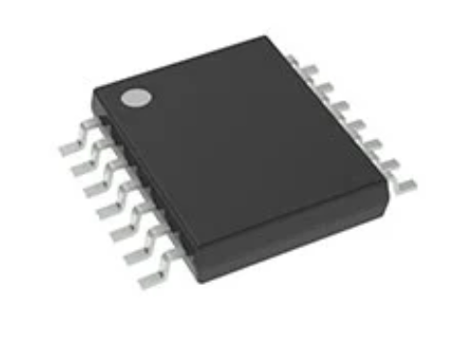
Commercial ADCs
Low price example: Texas Instruments PCM1808PWR
  Designed for audio encoding
    2-channel (i.e. stereo)
    24-bit resolution
    96 kHz sample rate
    Serial interface
$1.47/ea

Slide 15
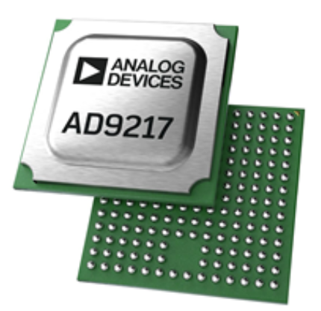
State of the Art ADC Example
Analog Devices AD9217BBPZ-10G
  Optimized for high speed data acquisition
    Single channel
    12-bit
    10.25 GHz digitization rate

Slide 16
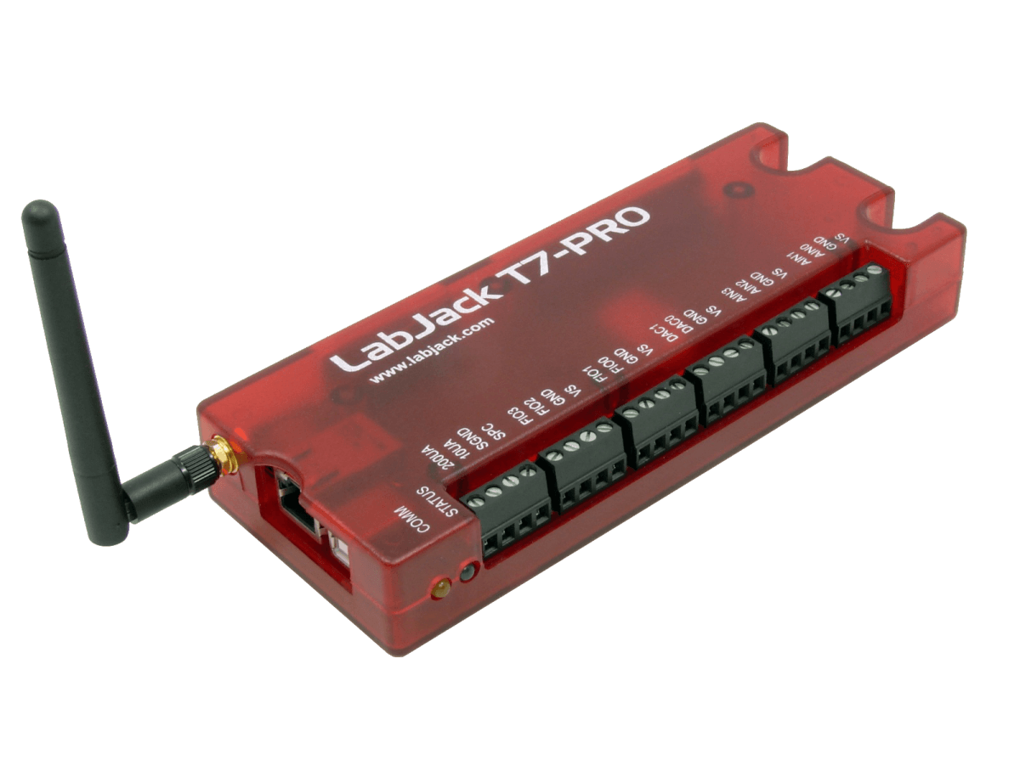
Commercial DAC/ADC Example
LabJack T7-Pro
  2 12-bit ADC inputs (0-5V)
  2 12-bit DAC outputs (0-5V)
  23 digital I/O
  Up to 10 internal counters/timers
  Wi/fi capable
  $850
(go to demo)

Slide 17
Accessing the ADC and DAC in the SoundCard
You can access the soundcard on your device by using the Ipython.display.Audio method and the sounddevice package
(Go to Demo)

